Slide 1

RISK AND RESILIENCE BOOTCAMP
4
Notes:
https://www.ncsc.gov.uk/static-assets/documents/PwnedPasswordsTop100k.txt

Slide 2


Slide 3
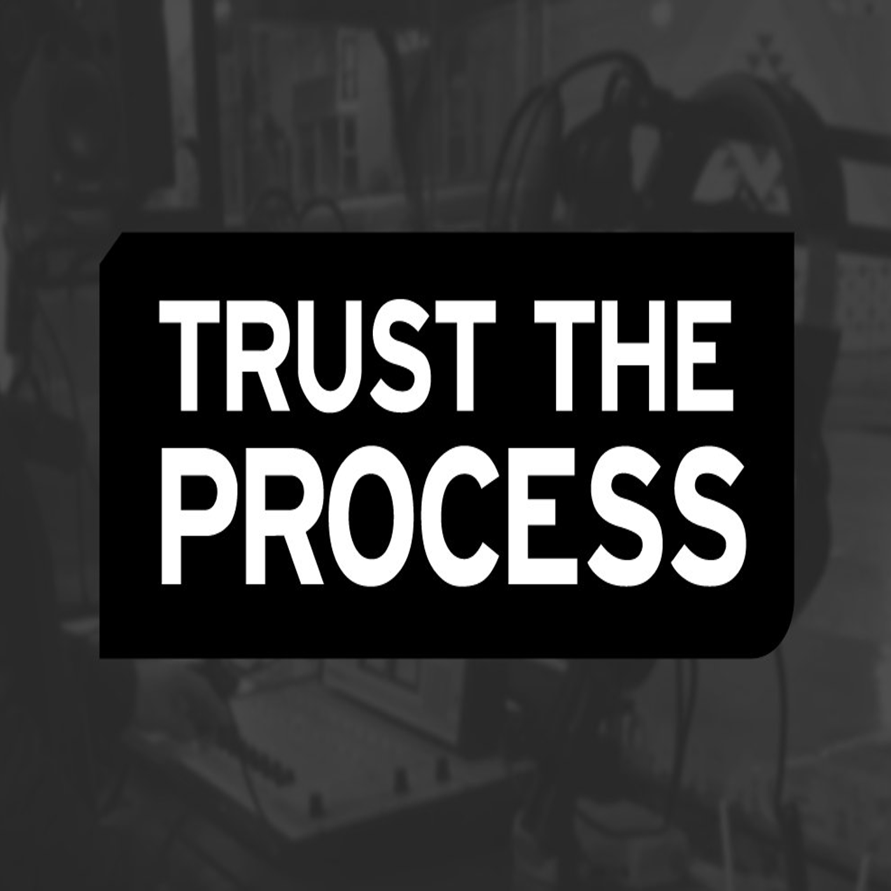
Process types
This section is an introduction into process models
This will include
Agile and adaptive methodologies
DevOps and DevSecOps
CI/CD automation

Slide 4
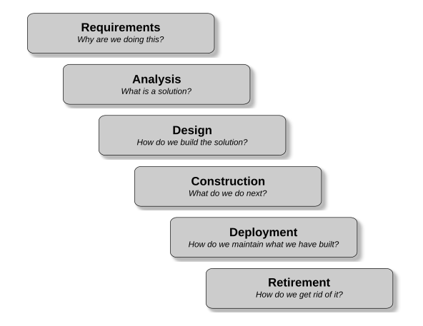
The Engineering Cycle
The Engineering Cycle: a set of logical steps
Each step builds on the previous one
How we apply this cycle is a “process type”
Waterfall process types
Completes each step in the process fully before moving on to the next step
Also called a “predictive” process because given the full set of requirements and technical constraints, we can accurately predict the final product will be
Common in engineering systems and high risk systems
Like nuclear reactor control software or airline navigation software
Or where requirements and technology don’t change over the lifetime of the project

Slide 5
In real life
For a lot of applications, the waterfall doesn’t work
There is often too much uncertainty and variation at each stage of the engineering cycle
Results in a lot of re-work as we respond to unplanned for change
These problems are not just software related
They were common across a variety of industries
Various alternatives to the waterfall approach were being experimented with
Collectively, these are referred to as adaptive methodologies
The continuously adapt to uncertainty and variations
Essentially incorporating risk and resilience into a production process
Most notable of these is Scrum

Slide 6
Risk in development
Project risk
Risk of the project not being delivered successfully
Risk of building software that creates more operational risk or has poor resiliency
Risk of wasting resources by building the wrong thing or building it poorly
Product risk
Risks that are created by using the project in production
Security vulnerabilities, problematic integration with legacy systems
Business risk
A faulty product may disrupt business operations in unexpected ways
Risk analysis cannot be relegated to post deployment of an application
This also leads to reputational risk

Slide 7
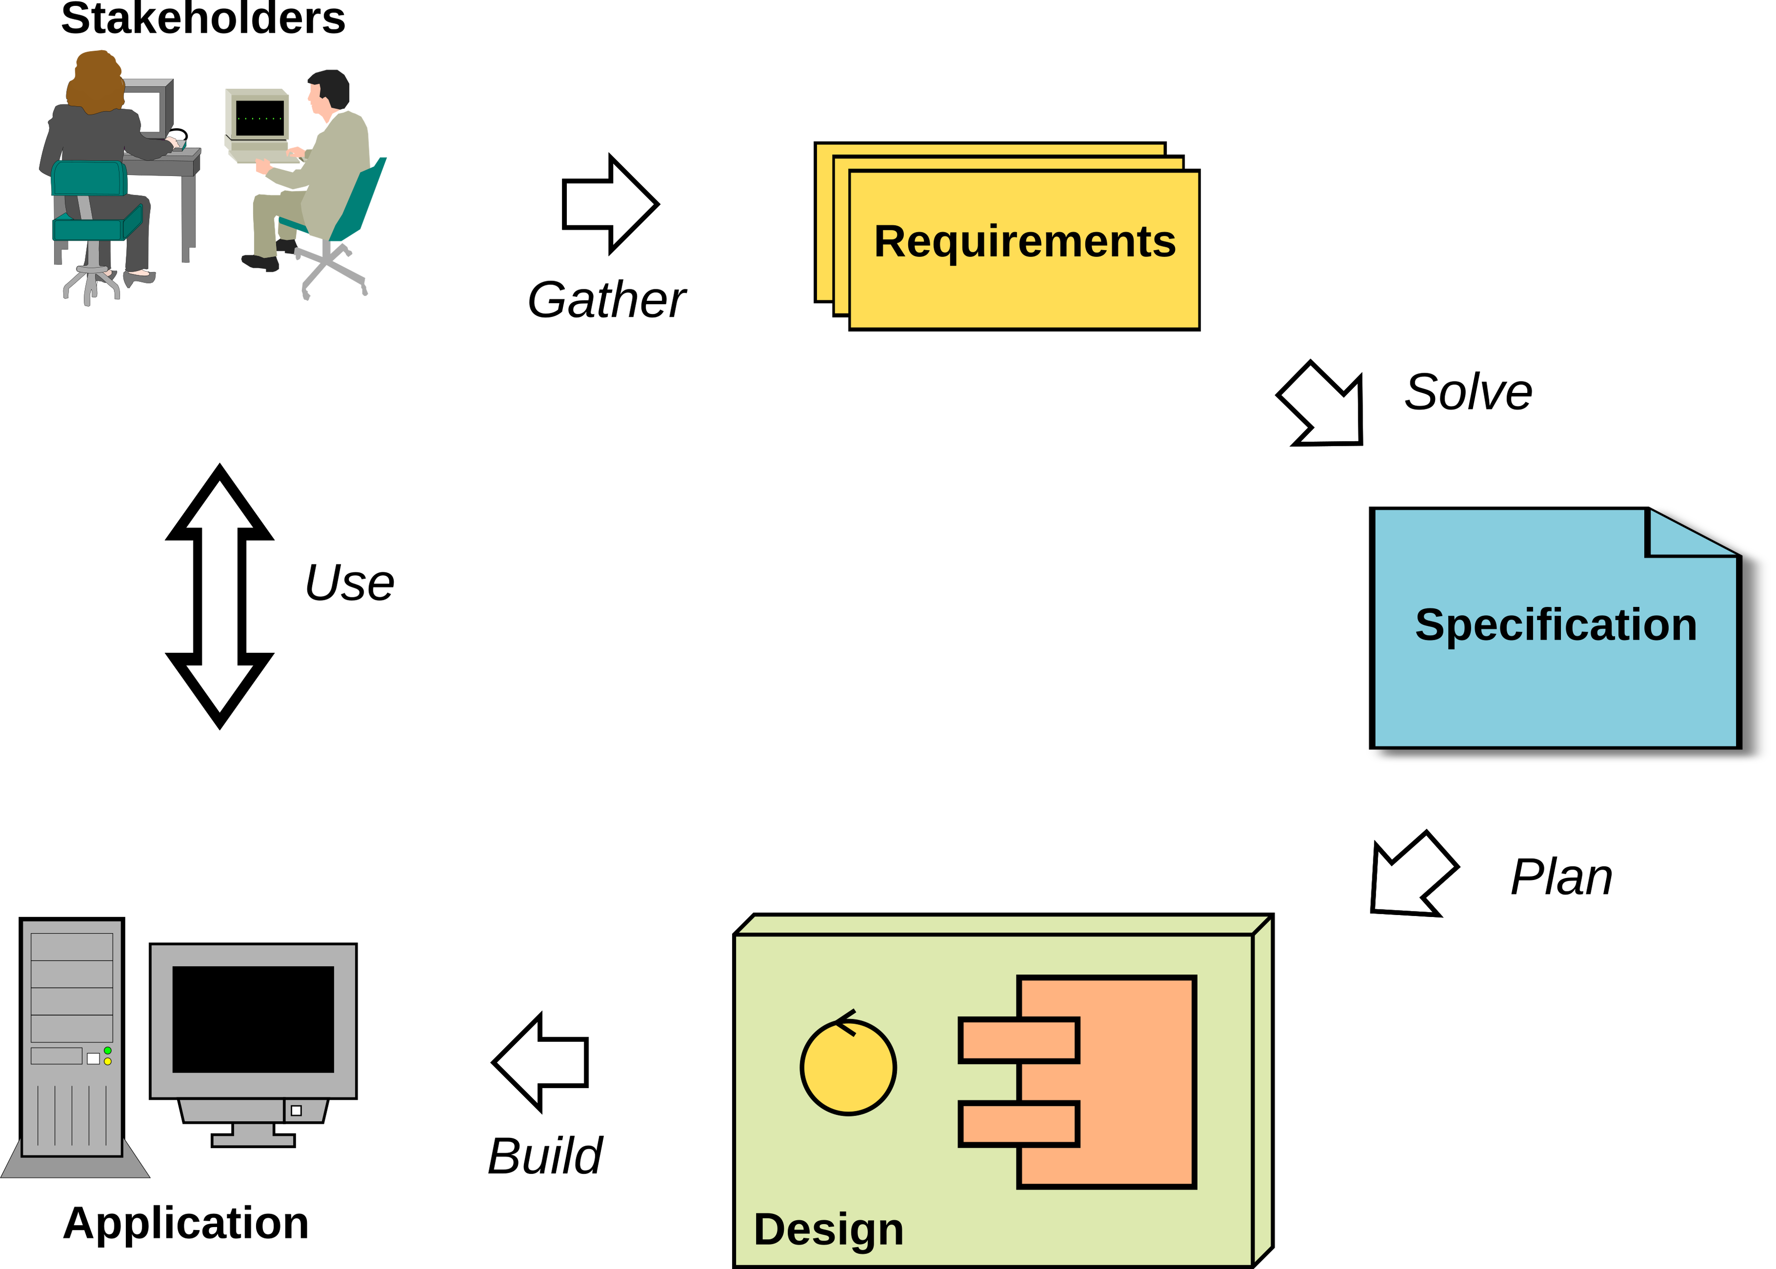
Generic development process
Most of the standard representations of the generic software development process are similar to the diagram
Traditionally, the deployment and retirement phases are ignored
DevOps does rectify this to a degree
Even Agile methodologies often only deal with the phases shown, not the operations and retirement phases

Slide 8
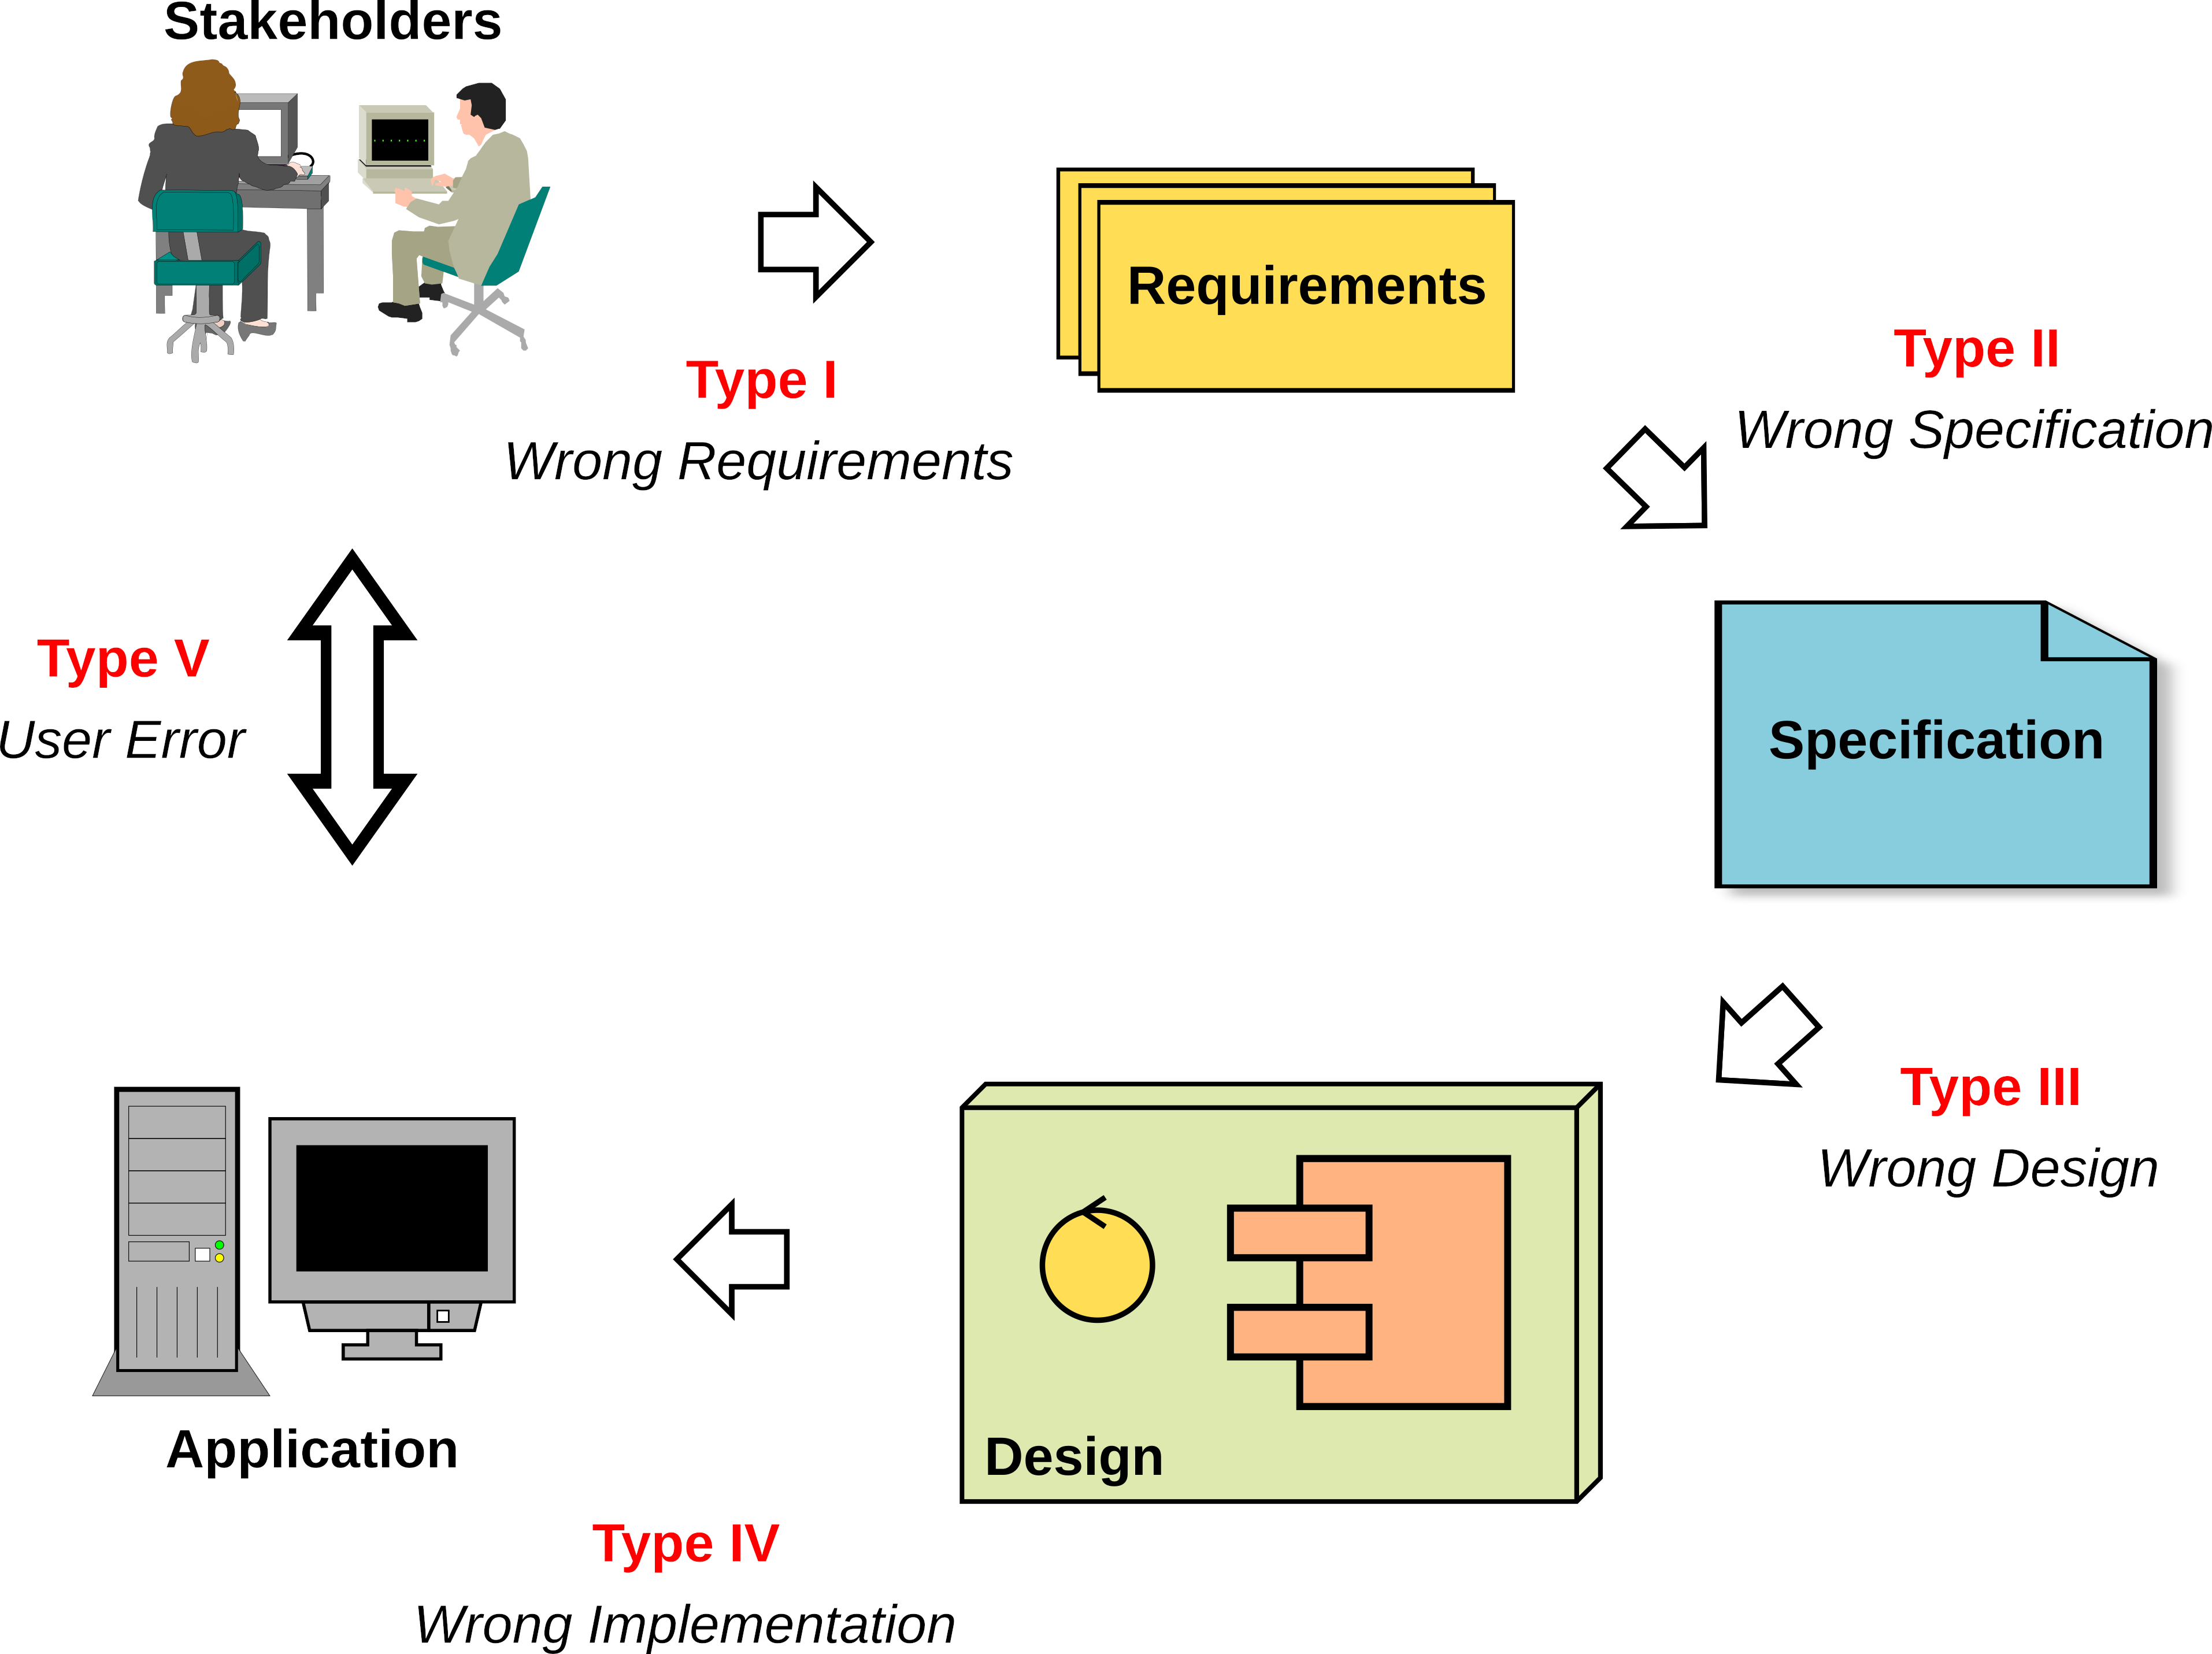
Where Things Go Wrong
Type I: Requirements are wrong
This is the most difficult kind of error to correct since it cannot be detected within the project but can only be detected with the participation of the stakeholders who are outside the development effort
In the worst case scenario, identification of the error takes place after the finished product is deployed and being used by the stakeholders

Slide 9
Where Things Go Wrong
Type II: Specifications do not satisfy the requirements
Our system may work perfectly, but it does the wrong thing perfectly
A type II error occurs if there are:
Requirements that are not addressed by the specification (omissions)
Features providing functionality that does not meet any requirement (surprise functionality)
Features that do not satisfy the requirements correctly (failures)

Slide 10
Where Things Go Wrong
Type III: System design does not meet the specifications
Following the design leads to a system that does not operate as specified
For example, the specifications may require the use of encryption for security, but the encryption methodologies were omitted in the design by mistake
Or the architecture proposed cannot handle the projected throughput, or exceeds the allowable response time

Slide 11
Where Things Go Wrong
Type IV: The system build and artifacts do not conform to the design
Someone made mistakes in building the system
Whether writing code or performing some other construction task that were specified in the design
Omitting error handlers for example

Slide 12
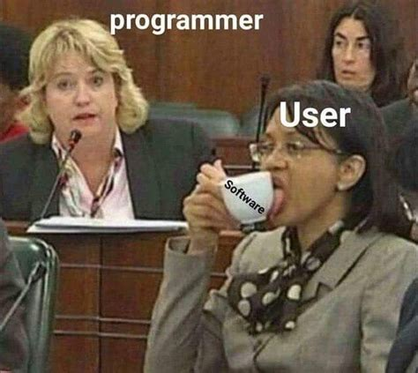
Where Things Go Wrong
Type V: User Error
This type of error is an unavoidable human error
The problem is that people do not always behave rationally and, while we may have designed and implemented everything correctly, it may be used in an irrational manner
It can also happen because users don’t know how to use the system or they are using it in a different context that it was intended
The study of this sort of predictable but irrational behavior is studied by the field of Behavioral Economics

Slide 13
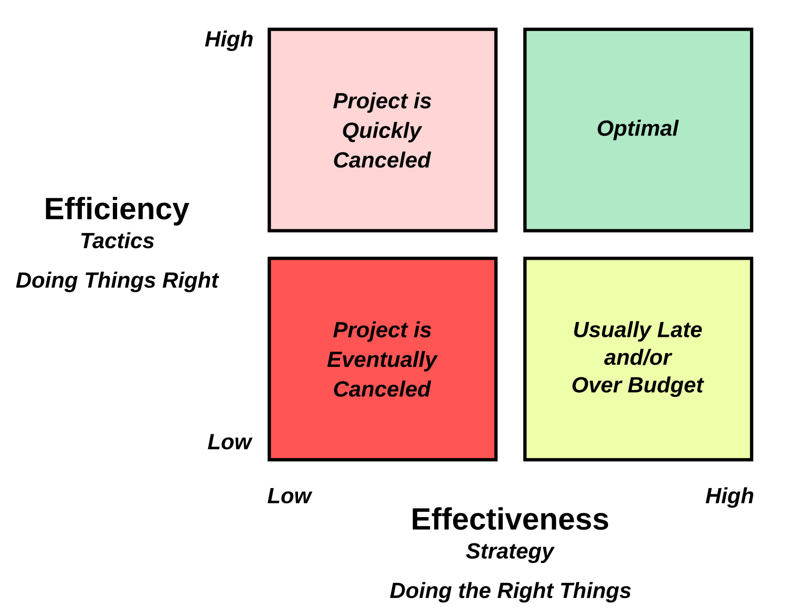
Efficiency and Effectiveness
Effectiveness:
A process is effective when it produces the right result
We often call this delivering to spec
Delivering software that meets the stakeholder needs and solves the business problems as it was intended to
Effective software development processes build the right software

Slide 14
Efficiency and Effectiveness
Efficiency:
A process is efficient when it is optimal in terms of how development resources are used
One of the main symptoms of a process inefficiency is how much rework is done during and after development
Rework is where previous work has to be done over because of errors made previously
Efficient software development processes build software correctly with the optimal use of resources

Slide 15
Error impact
These errors introduce risk and potential resilience failure
Unless the errors are caught, we have introduced risk into the product
We also have introduced multiple points of potential failure
If we unaware of where the potential point of failures are, resilience is compromised
“The most important single aspect of software development is to be clear about what you are trying to build. Dijkstra ”
If we don’t know what we are supposed to be building
Then we will never know if we are building the right thing
The data suggests that projects often don’t know what they supposed to be building

Slide 16
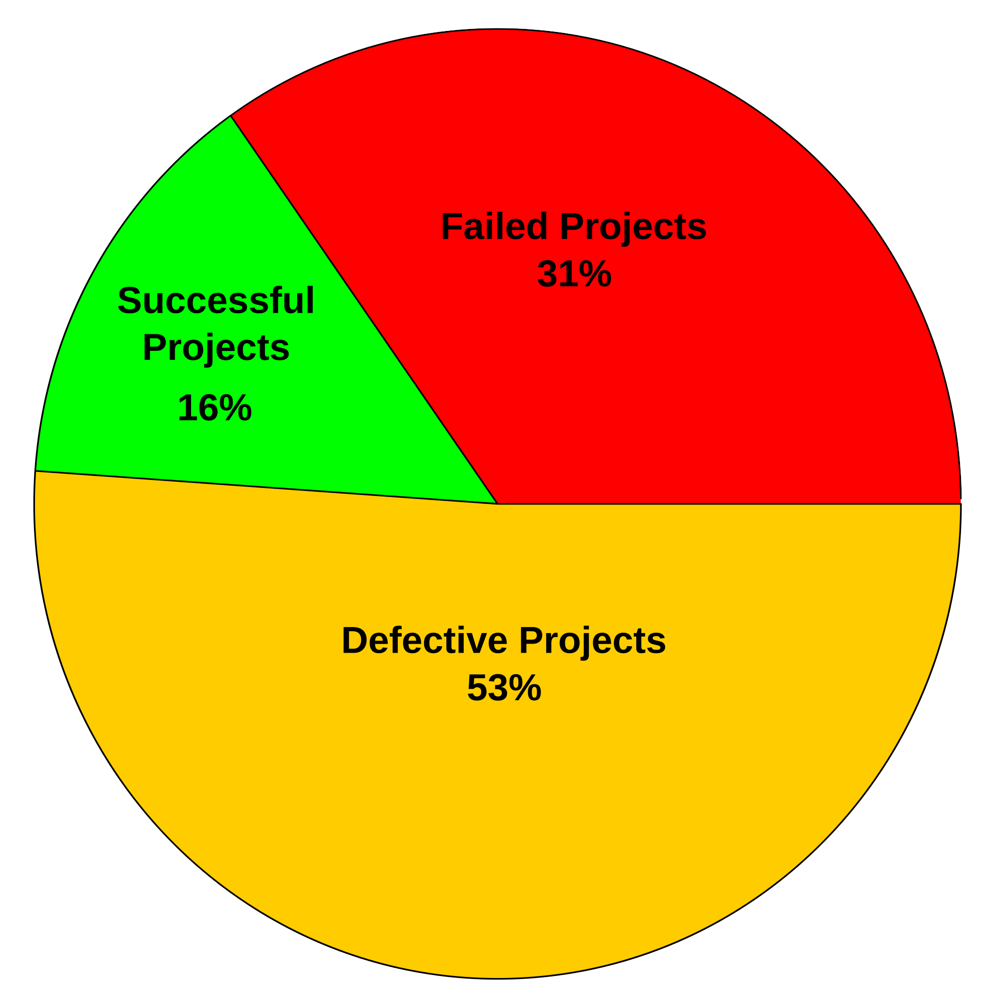
The Chaos Report
Annual report from the Standish group
Defines three resolutions for technical projects:
Resolution Type 1 – Successful Projects:
The project is completed on-time and on-budget
All features and functions as initially specified.
Acceptance tests all pass
Resolution Type 2 – Defective Projects:
The project is completed and operational but over-budget and/or late and/or is delivered fewer features and functions than originally specified
Usually with acceptance test failures
Resolution Type 3 – Failed Projects:
The project is canceled at some point during the development cycle

Slide 17
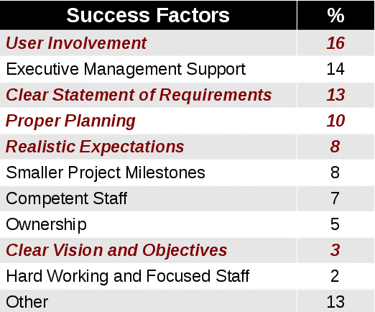
Successful Project Factors
The table lists the factors that were identified by people on the project as being responsible for a project being successful
The red italicized factors are those that are related to requirements and interactions with the users and stakeholders
Two of the top three items concern quality of requirements and getting the users involved
The fifth item, realistic expectations, suggest that the developers had early input into the project to help the business understand what could be done within the time and budget constraints of the project

Slide 18
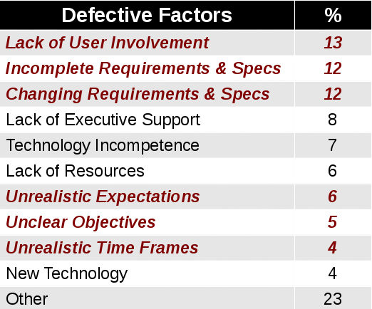
Defective Project Factors
The table lists the factors that were identified by people on the project as contributing to a project being challenged or defective
By definition a challenged project is one that was completed but either missed its budget targets, delivery date or did not perform as originally specified
The top three reasons why projects were defective or challenged have to do with specifications, requirements and user involvement
The more chaotic the requirements and specification, the less the developers know what they should be building

Slide 19
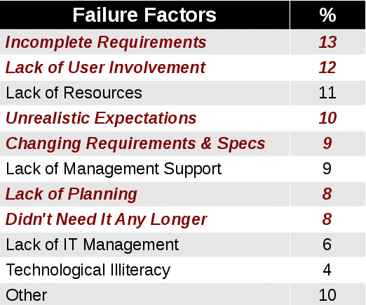
Failed Project Factors
The table lists the factors that were identified as contributing projects being canceled as ranked by people on the project
Again, we see that requirements and specification issues and user involvement are right at the top
The unrealistic expectations suggests that what the business wanted to be built was beyond the technical solutions that could be reasonably be delivered by the developers

Slide 20
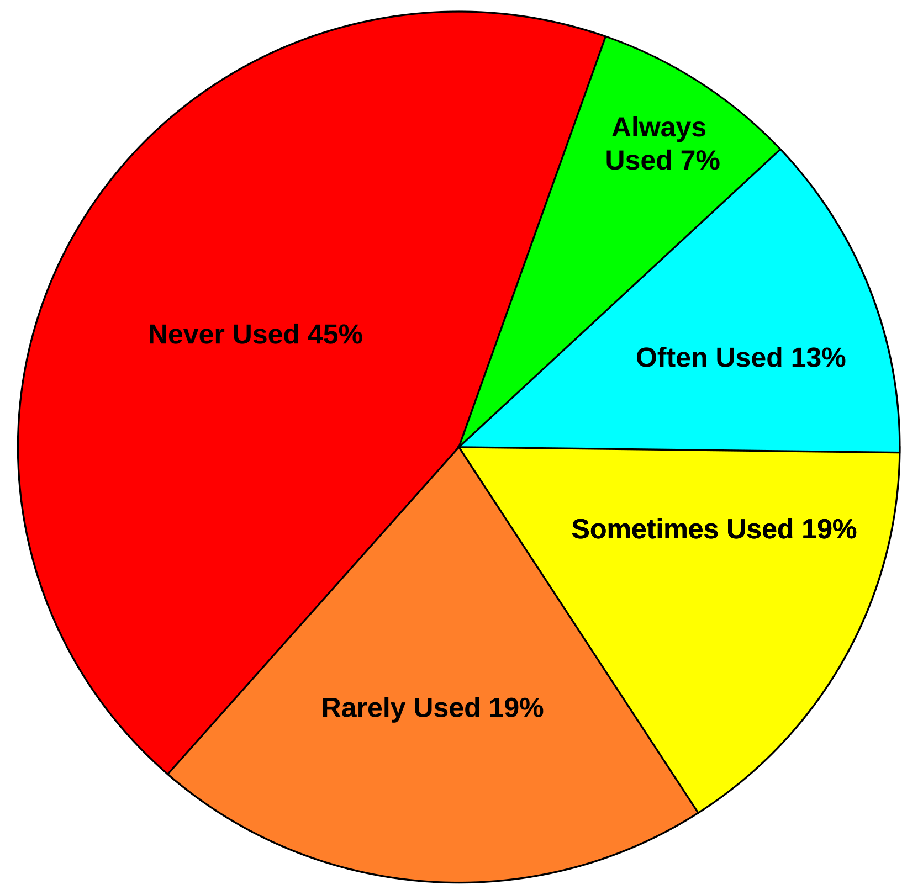
Over Engineering
The diagram shows the frequency of use of the features in a delivered software project
These numbers are from the Chaos report
Only 20% of the delivered features are always or often used
Almost half the features are never used on average
This means that about 45% of the development effort is wasted
We used resources and time to build things that never needed to be built
Usually happens because the feature choice is made by developers working without knowing the requirements the system needs to satisfy

Slide 21
Over Engineering
Over engineering is a combination of development ineffectiveness and inefficiency
Because we do not know what the end user really needs, we waste resources building things that never needed to be built at all
The application is ineffective in solving the original motivating need or requirement
In terms of efficiency, if we focus on the most important features first and defer building features that contribute little value, we have increased the efficiency of the process without compromising effectiveness
Creates significant risk and resilience problems

Slide 22
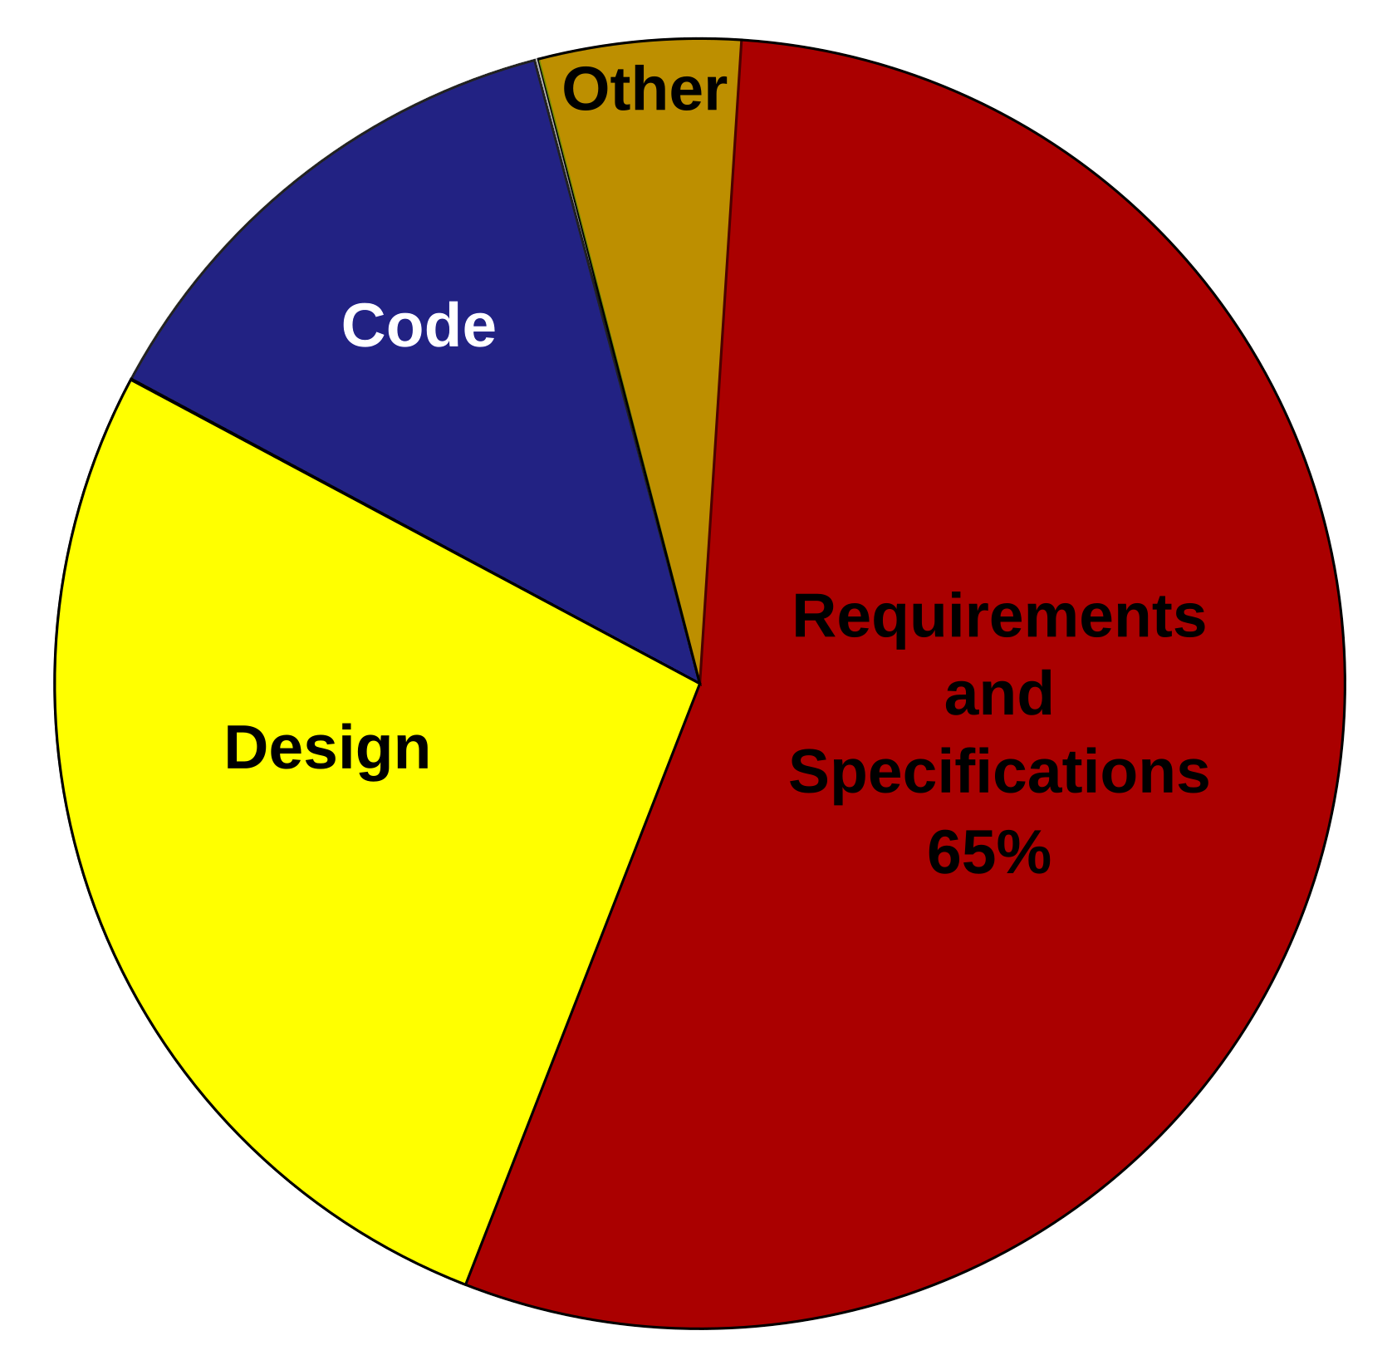
Source of Errors
In a study by Gupta et al, the place in the process where errors originated from is shown in the pie chart
What is the impact of errors in previous phases of a project?
We either get a defective or canceled project
Or we have to do a lot of rework to correct errors that have resulted working from wrong requirements or specification

Slide 23
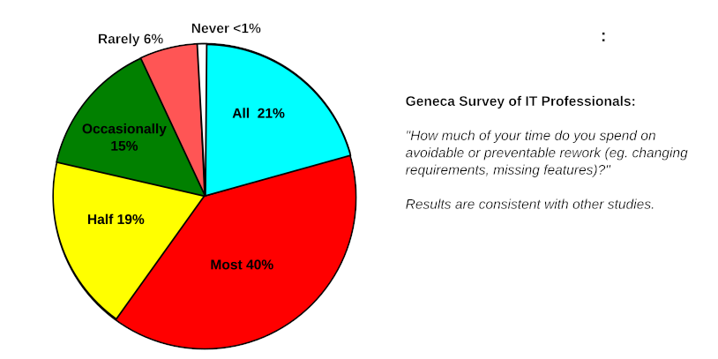
Rework Effort
All of this so far can seem bit academic until we ask the really important
Question: how much of developer time is taken up with fixing errors that could have been prevented?
61% of the IT professionals surveyed said they spent all or most of their time fixing things they felt were preventable
When we add in those who spend half their time fixing mistakes, then 80% of IT professionals spend at least half their time on is fixing mistakes that could have been prevented

Slide 24
Risk and resilience issues
Errors in the planning, design and building of software
Are a root cause of risk and resilience failures in other environments, like operations
The lack of controls in development forces more controls in operations
Could be considered inherited risk from development into operations
Errors that propagate into operations means that
The resilience of the software is essentially unknown
Failures and outages blindside operations
There are no clear ways to return to operations

Slide 25
Risk and resilience issues
Even if the software itself is error free
There are risks that
The business requirements for the software have changed
The operational environment the software runs in has changed
The regulatory requirements that govern the software functions have changed
The designed resilience features of the software
May not satisfy changed functional or operational requirements
May not work in a changed operations environment
May not meet changed recovery requirements

Slide 26
Scrum
Scrum was not originally intended for software development
Originally proposed in industrial manufacturing in the 1950s-1980s
Very influential: basis of Lean manufacturing, implemented in the Toyota production system
In the 1980s, there was a major crisis in software development
Software was being developed in a big-bang approach
Siloed teams (design, development, testing) worked in isolation with one-time hand offs of artifacts
NATO software engineering conference in 1968 was held to address the high failure rate of these big-bang projects
The conclusion of this and other similar conferences was that in incremental and iterative approach, like Kaizen (continuous improvement) and lean approaches to product development were needed

Slide 27
Scrum
The term Scrum is first used in 1986 with reference to new product development
Hirotaka Takeuchi and Ikujiro Nonaka “The New New Product Development Game”
Jeff Sutherland & Ken Schwaber (1997)
Presented the first public paper on Scrum: "SCRUM Development Process."
Emphasized:
Empirical process control theory (transparency, inspection, adaptation)
Lean principles
Nonaka & Takeuchi’s knowledge-creation theory (SECI) – the basis for cross functional teams
The basic ideas expressed in Scrum started to be adopted generally
Primarily by teams working with volatile types of projects
Often smaller teams of developers working closely with the business side

Slide 28
Scrum
In the 1980s and 1990s
Companies experimented with using what they called adaptive development
IBM, DuPont, and others experimented with iterative prototyping and empirical process control
Characterized by
Use of successive prototypes to get feedback on requirements, design and performance
Short iterations (one month or less)
Cross-functional teams
Daily meetings for synchronization
A prioritized feature list

Slide 29
Formalization of Scrum
2002
Scrum Alliance founded to promote Scrum through certifications, communities, and training
2009
Jeff Sutherland & Ken Schwaber publish "Scrum Guide (1st Edition)"
First formal codification of Scrum as a lightweight framework.
Defined its roles, events, artifacts, and rules
2010s
Widespread adoption beyond software
Scrum principles applied to: Marketing, HR, education, and hardware development
Applied to entire organizations (Enterprise Scrum, Scrum@Scale, LeSS, Nexus)

Slide 30
Formalization of Scrum
2010
Scrum.org founded by Ken Schwaber
Alternative certifying body with a focus on assessment-driven learning
2017
Major scrum guide update
More emphasis on values: commitment, focus, openness, respect, courage
2020
Scrum guide simplification
Roles streamlined
Focus on a single Scrum Team with a shared goal
Removed prescriptive elements to broaden use outside software

Slide 31
Major Ideas Incorporated into Scrum
Empirical process control
Transparency, inspection, adaptation
From Lean manufacturing and scientific method
Cross-functional, self-organizing teams
From Takeuchi & Nonaka and Lean
Iterative and incremental development
Inspired by early software engineering pioneers

Slide 32
Major Ideas Incorporated into Scrum
Small batches and feedback loops
From Lean manufacturing and prototyping
Knowledge creation and tacit knowledge sharing
From Nonaka’s work on organizational learning
Focus on people and communication
From Fred Brooks and Extreme Programming values
Timeboxing
Borrowed from project management and software engineering experiments in the 1980s–90s

Slide 33
Frameworks and Methodologies
A common mistake is to call Scrum an Agile methodology
It is not a methodology, it is a process framework
Failure to have a methodology defined while using Scrum negates the value of using it
Scrum is process-focused
Managing what and when
Agile methodologies are practice-focused
Describing the concrete steps to get the work
The two complement each other
Scrum without a software engineering methodology risks low quality
A software engineering methodology without Scrum risks lack of direction and prioritization

Slide 34
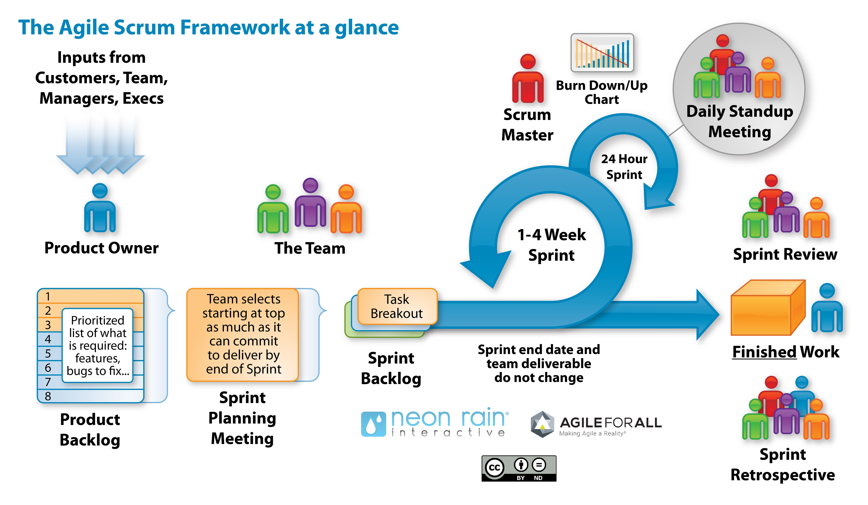
Scrum at a glance

Slide 35
Uncertainty
A big bang process is not generally possible unless
Everything is known about the requirements, possible solutions, designs
All and any potential causes of failure for the application
Very common for stable engineering environments like civil engineering
Also used for very high risk of mission critical software (eg, nuclear reactor controls)
However, this is not the majority of product development projects
We may not know all the requirements until users see a prototype
We may not know if proposed solutions actually solve the problem until we prototype
We may not know if designs are feasible until we try them out (reliable, affordable and resilient)
These unknowns at each stage of the process create “slippage”
Unless resolved, typically the project fails or is defective

Slide 36
The cone of uncertainty
Comes from the challenge of software estimation
Goal is to establish estimates of costs, timelines and functionality
Estimates are based on available data
Early in the project, the data may only be available as best guesses
This means estimates have a range of uncertainty
As the project progresses
The estimates can be refined with data collected during development
This narrows the range of the original estimates
At the end of the project, the estimate converges to the actual final values
These may be out of the range of the original estimates

Slide 37
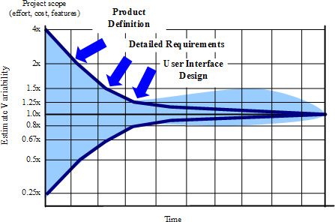
The Cone of Uncertainty

Slide 38
Scrum as a Risk Management Framework
Scrum is inherently designed to manage risk
It integrates well with risk practices
Even if it doesn’t use traditional risk registers or ISO-style controls
Risk related features
Short, iterative cycles (sprints) limits exposure to large failures
Continuous feedback and review: identify problems early
Empowered teams and transparency: enable quick response to uncertainty
Scrum is risk-responsive by design
Excellent foundation for integrating formal risk and resilience practices

Slide 39
Scrum and Uncertainty
The cone of uncertainty
Warns us that early estimates are unreliable, including risk estimates
Especially the estimates remain fixed during the development process
Scrum approaches this problem by using
Iterative delivery to reduce uncertainty through working increments
Empirical velocity-based forecasting using evidence, to make estimates more accurate
Backlog reprioritization to optimize value as the cone narrows
Scrum actively forces the cone to narrow
Studies on IT projects shows that incremental and iterative processes have lower rates of project failure and have more accurate estimates of timelines and budgets

Slide 40
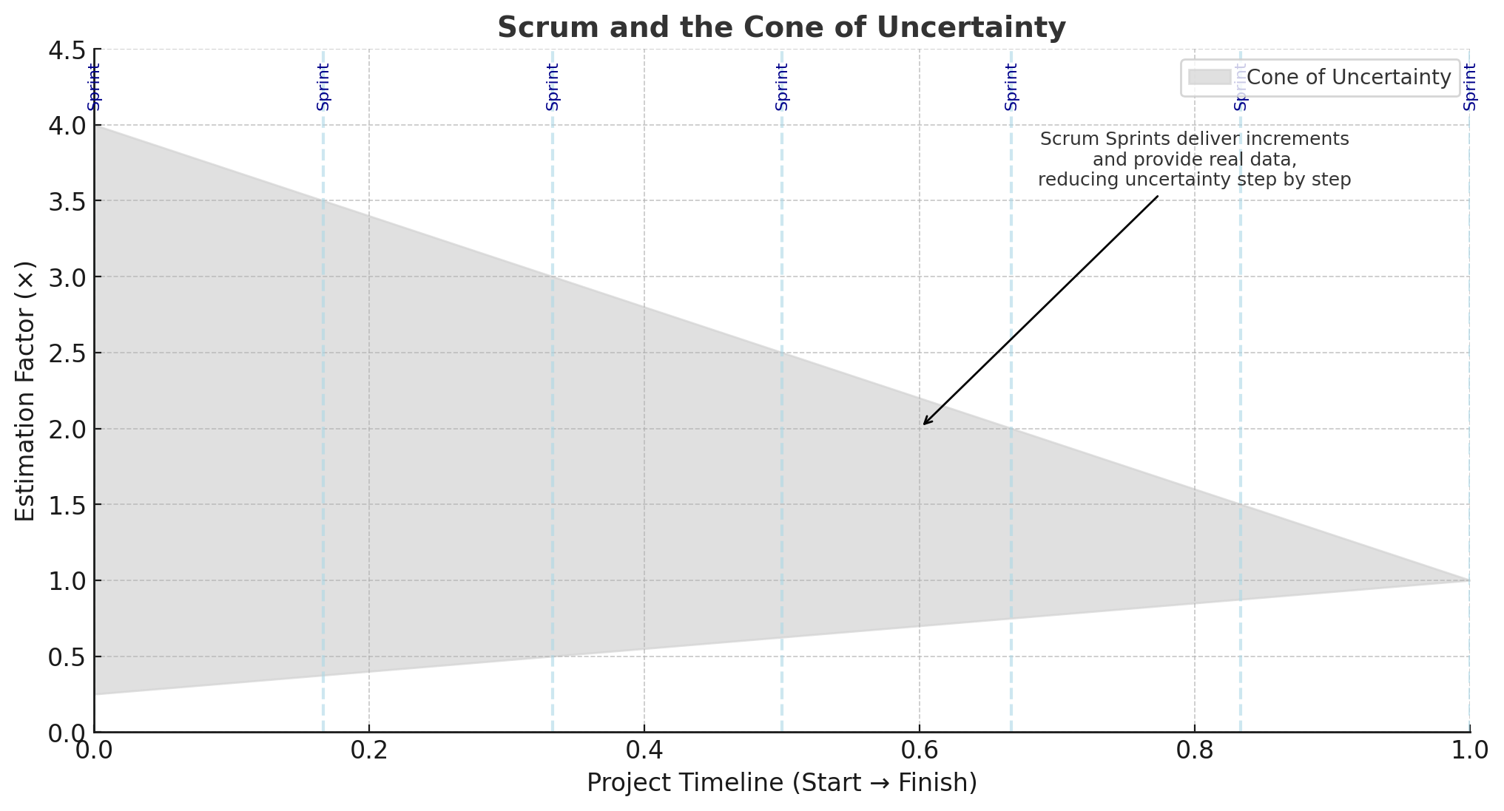

Slide 41
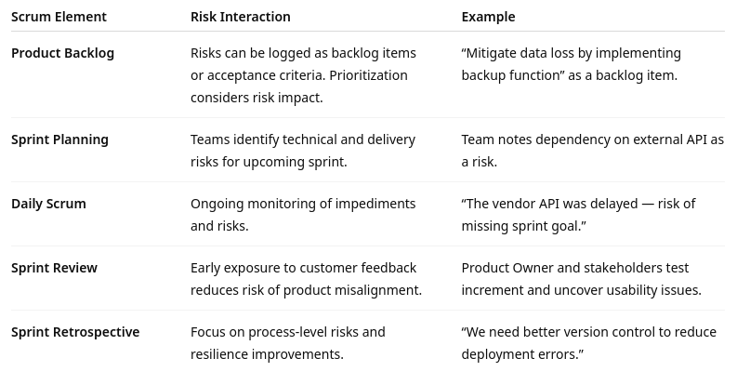
Risk Management in Scrum

Slide 42
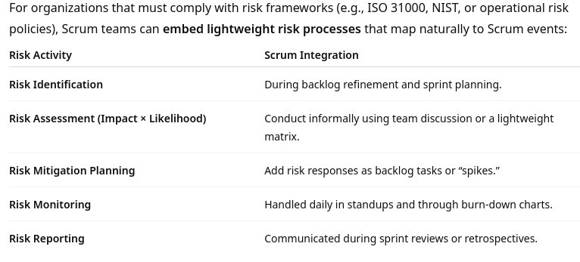
Formal Risk Management in scrum
s

Slide 43
Scrum and Resilience
Iterative delivery
Builds system redundancy and recovery capability
Scrum uses short sprints
Ensure that software and systems are developed, tested, and deployed in small, recoverable increments which supports early identification of potential points of failure
Improves resilience by having
Smaller blast radius: If a deployment fails, only a limited set of features are affected
Frequent integration/testing: Continuous validation ensures the system is always in a working state
Regular delivery of value: If a disruption occurs, previously delivered increments remain usable and stable, and reduces time to recovery
Example:
A financial services platform using Scrum deploys new modules every two weeks
When a database migration issue arises, rollback is simple: only the sprint’s incremental update needs to be reverted, not the entire system

Slide 44
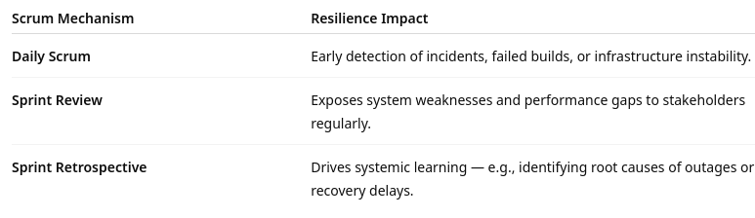
Scrum and Resilience
Embedded inspection and adaptation
Empirical process control: inspect–adapt–transparency
These feedback loops create an organizational culture where failure is expected, analyzed, and used to improve recovery mechanisms for the products

Slide 45
Scrum and Resilience
Cross-functional teams reduce single points of failure
Naturally distributes knowledge and responsibility across roles
Reduces organizational fragility
Developers, testers, and ops staff collaborate daily: no “handoff silos”
Knowledge sharing collaborative processes ensures redundancy in expertise
Avoids having only one group or individual who understands the system resilience
Resilience knowledge about the application
Becomes an emergent property of how the team operates
Not something added on later

Slide 46
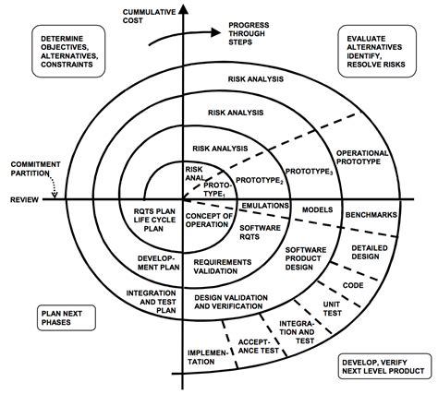
Spiral methodology
Developed by Barry Boehm in 1986
Spiral Model integrates elements of both design and prototyping-in-stages
Introduced iterative development into the waterfall approach
Emphasizes risk-driven development.
Each iteration (or “spiral”) is designed to identify and reduce key risks early
Including technical, financial, operational organizational
Before committing to the next phase

Slide 47
Phases of Each Spiral
Each cycle follows four repeating stages
Objective setting and planning
Define goals, constraints, and alternatives for the iteration
Determine what risks could impact progress
Risk analysis and evaluation
Identify and assess risks in technical, operational, or business dimensions
Develop mitigation strategies or prototypes to address them
Development and validation
Build and test deliverables (could be a prototype, a process change, or an operational control)
Incorporate feedback and validate against objectives
Review and planning for next iteration
Evaluate results and decide whether to continue, adjust, or terminate the project
Plan the next spiral with updated risk insights

Slide 48
Spiral methodology
Key characteristics
Iterative: Continuous refinement rather than a one-time plan
Risk-driven: Every cycle begins with risk assessment and mitigation
Flexible: Supports changes as understanding deepens
Stakeholder Involvement: Users and sponsors participate in reviewing progress and validating outcomes
Relevance to risk and resilience
Models risk awareness as a process, not a one-time assessment
Encourages continuous improvement through iteration, similar to Agile retrospectives
Aligns well with resilience thinking: learn, adapt, and improve after each cycle
Provides a structured yet adaptive approach to managing uncertainty

Slide 49
Scrum and Agile
Agile was the general term adopted in 2001
Defined by owners of adaptive methodologies that shared a similar approach to development
Derived many of their ideas from their use of Scrum ideas
For example: Extreme Programming, Feature Driven Development
Many of the features of Scrum were incorporated into the Agile Manifesto and the Agile Principles
Note that Scrum is NOT an Agile methodology, but its concepts were shared among Agile methodologies
Specifically:
Individuals and interactions
Working software prototypes
Customer collaboration and feedback loops
Responding to change in a planned systematic way

Slide 50
Agile manifesto
Agile methodologies tend to incorporate Scrum practices
Scrum is focused on process
Agile tends to focus on the type of work done during the process
Agile manifesto and principles
Summary of the common approach taken by the different Agile methodologies
The principles are a set of characteristics common to Agile teams
Each methodology has its own way of implementing the principles

Slide 51
Agile principles
Agile principles
Our highest priority is to satisfy the customer through early and continuous delivery of valuable software
Welcome changing requirements, even late in development
Agile processes harness change for the customer's competitive advantage
Deliver working software frequently, from a couple of weeks to a couple of months, with a preference to the shorter timescale
Business people and developers must work together daily throughout the project
Build projects around motivated individuals
Give them the environment and support they need, and trust them to get the job done
The most efficient and effective method of conveying information to and within a development team is face-to-face conversation
Working software is the primary measure of progress

Slide 52
Agile principles
Agile processes promote sustainable development
The sponsors, developers, and users should be able to maintain a constant pace indefinitely
Continuous attention to technical excellence and good design enhances agility
Simplicity – the art of maximizing the amount of work not done – is essential
The best architectures, requirements, and designs emerge from self-organizing teams
At regular intervals, the team reflects on how to become more effective, then tunes and adjusts its behavior accordingly

Slide 53
Extreme Programming (XP)
Developed in the late 1990s by Kent Beck
One of the original Agile methodologies
Designed to improve software quality and responsiveness to changing customer requirements through frequent releases, continuous feedback, and disciplined technical practices
Core ideas
XP focuses on adaptability, collaboration, and technical excellence
Pushes core agile principles to the “extreme”
Ensuring that teams can deliver value rapidly and sustainably even in high-uncertainty environments

Slide 54
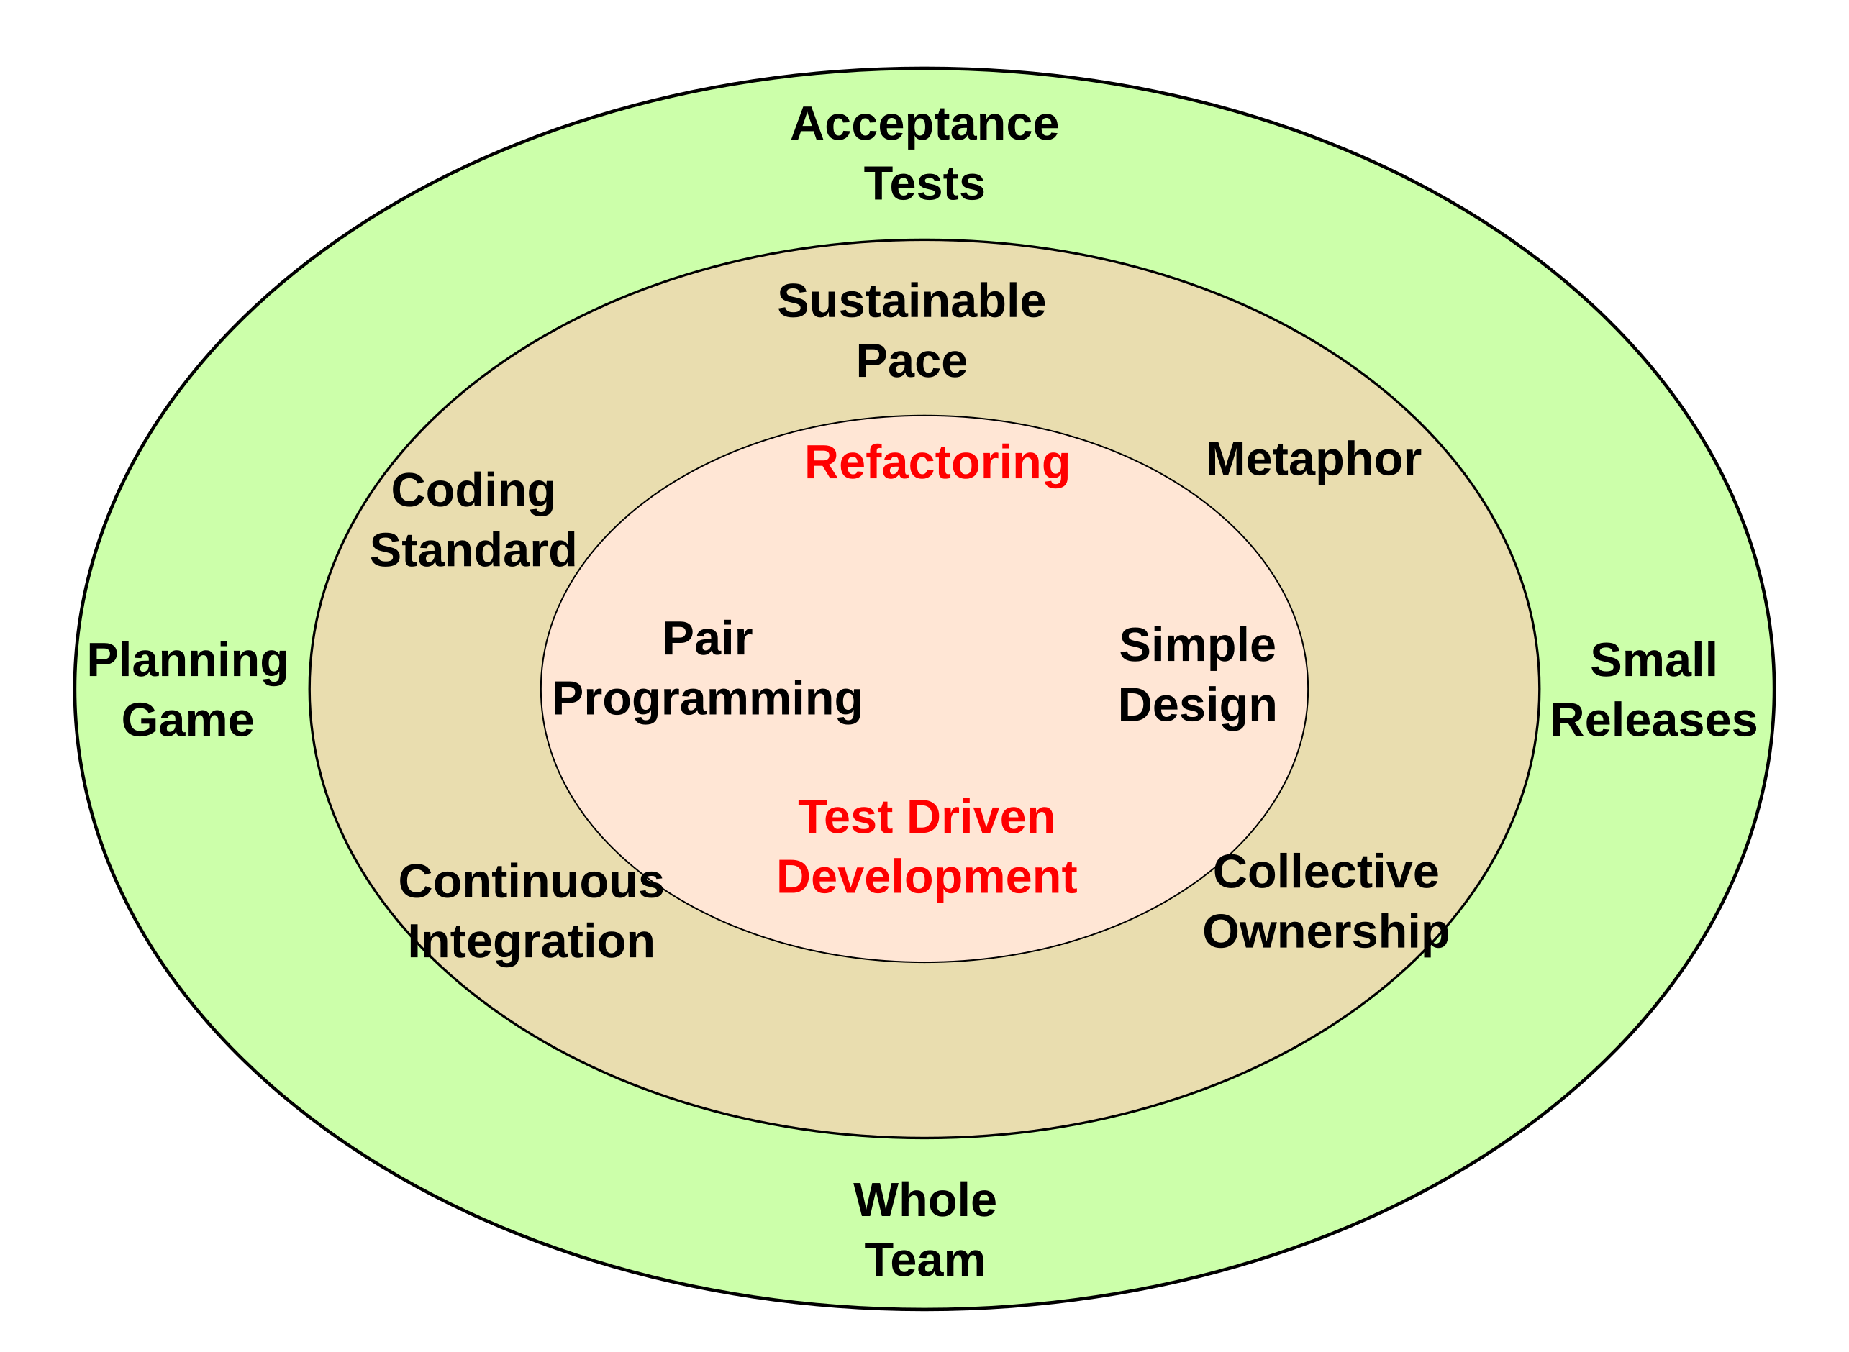
Extreme Programming (XP)

Slide 55
Extreme Programming (XP)
Core practices
The Planning Game
Customers and developers cooperate to produce the maximum business value as rapidly as possible
Small Releases
Start with the smallest useful feature set.
Release early and often
Adding a few features each time
Metaphor
Each project has an organizing metaphor, to provide an easy to remember naming convention
Simple Design
Always use the simplest possible design that gets the job done
The requirements will change tomorrow, so only do what's needed to meet today's requirements
Continuous Testing (TDD):
Tests are written for a feature to be added, then the code is written
When the suite passes, the job is done

Slide 56
Extreme Programming (XP)
Refactoring
Refactor out any duplicate code generated in a coding session
You can do this with confidence that you didn't break anything because you have the tests
Pair Programming
All production code is written by two programmers sitting at one machine
Essentially, all code is reviewed as it is written
Collective Code Ownership
No one "owns" a module
Anyone is expected to be able to work on any part of the codebase at any time
Continuous Integration
All changes are integrated into the codebase at least daily
The tests have to run 100% both before and after integration

Slide 57
Extreme Programming (XP)
40­Hour Work Week (Sustainable Pace)
Programmers go home on time, up to one week of overtime is allowed
On­site Customer Tests
Development team has continuous access to a real live customer
Someone who will actually be using the system who does continuous test generation and acceptance
Coding Standards
Everyone codes to the same standards so that there is no way to tell by inspection who on the team worked on a specific piece of code

Slide 58
Extreme Programming (XP)
Key characteristics:
Highly iterative and incremental: Frequent releases and feedback loops
Human-centered: Collaboration and trust are central
Quality-Driven: Testing, integration, and refactoring prevent defects
Adaptable: Embraces change as part of the process, not a disruption
Relevance to risk and resilience:
Risk reduction through immediacy: Frequent integration and testing surface risks early
Operational resilience: Collective ownership builds fault tolerance in teams
Process resilience: Practices like refactoring and TDD create systems that can evolve safely
Human resilience: Sustainable pace and teamwork mitigate burnout and turnover risks

Slide 59
DevOps
The result of improvements in hardware speed and capacity
Previously the limiting factor in computing was hardware
Faster and more powerful hardware
Meant that software did not fully utilize the hardware capability
The model of one operating system to one physical host became wasteful
Virtualization
Developed by IBM in the 1970s to support multiple operating systems on a single physical host, at that time, mainframe
Established a translation layer between the virtual Os and real OS called a hypervisor

Slide 60
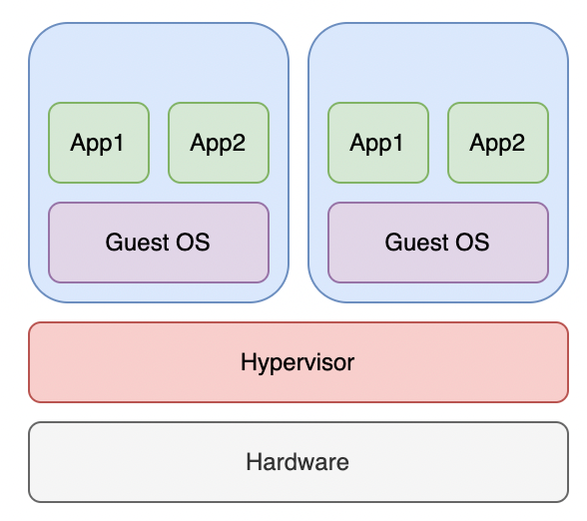
DevOps
The virtual environment
Executes code on the hypervisor
Creates a virtual representation of a physical device like a computer or disk drive
Maps the virtual device to some underlying hardware resource on the underlying host
Tools like Terraform are
Used to specify the virtual resources required
Executed by the hypervisor or equivalents
Called “Infrastructure as Code” or IoC
Note: this is a simplification of what really happens

Slide 61
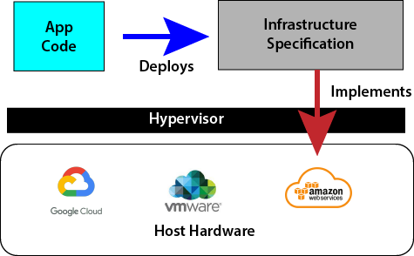
DevOps

Slide 62
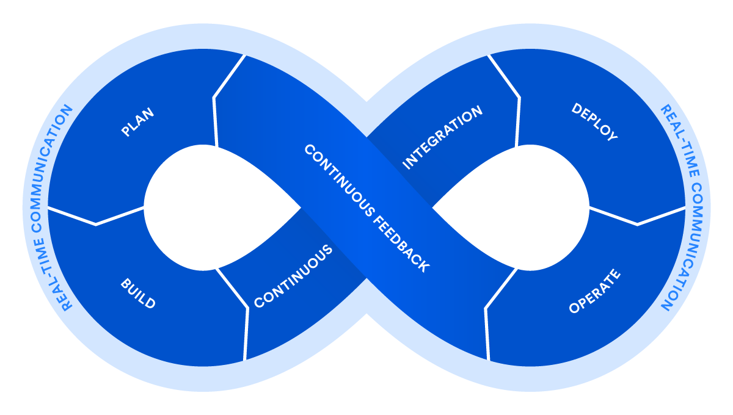
DevOps
Driven by virtualization and Infrastructure as code
Dev and Ops had been two separate worlds
Dev was generally automated
Ops was manual and bare metal
Virtualization turned it all into code
Now the same tools can be used in the entire life cycle of a software product
Opportunity for full process automation support
Enables immediate feedback loops between dev and ops

Slide 63
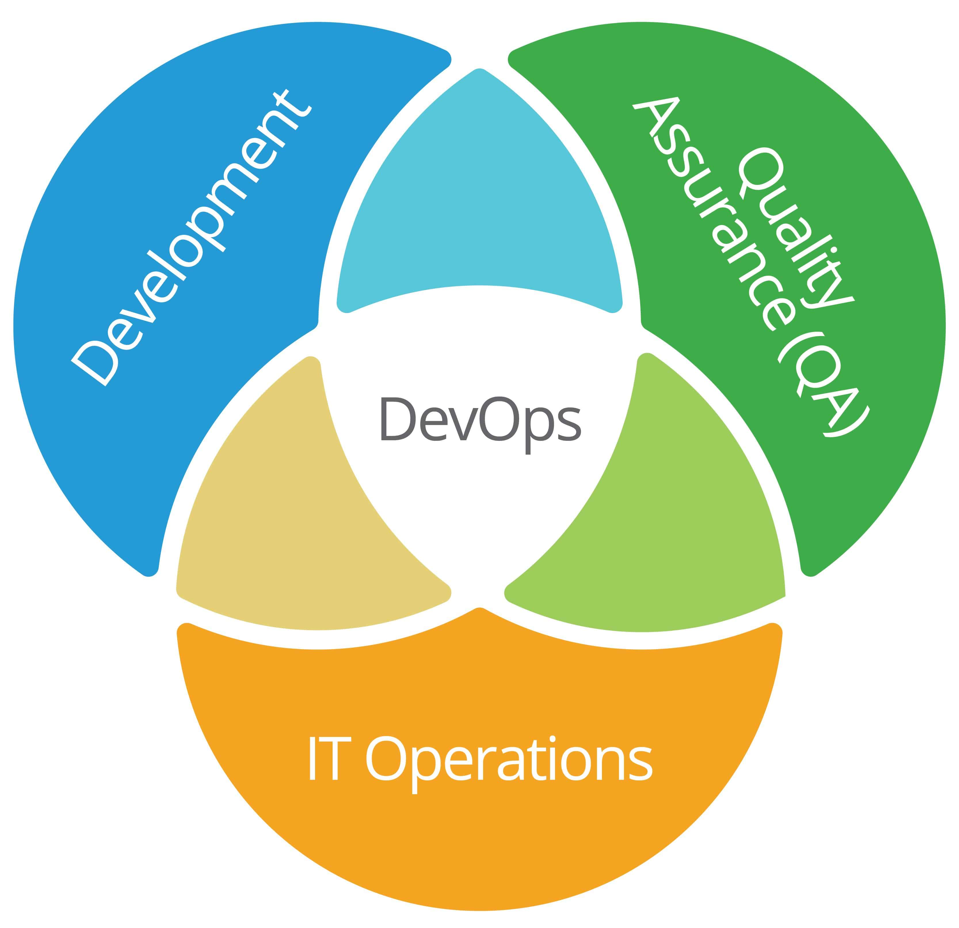
The Goal of DevOps
Desilo-ize the three areas in software development
Get everyone using the same sorts of tools, practices and automation
Better collaboration
More control over the entire lifecycle of software

Slide 64
Positive Impact on Risk and Resilience
Faster detection and response to risk
Continuous integration and monitoring mean issues are identified and remediated early
Automated testing and deployment reduce human error during releases
Real-time observability (logs, metrics, alerts) improves situational awareness and shortens the mean time to detect (MTTD) and mean time to recover (MTTR)
Resilience gain
Systems and teams become more responsive and adaptive to incidents

Slide 65
Positive Impact on Risk and Resilience
Improved change management and reliability
Frequent, smaller deployments reduce the risk of large, disruptive failures
Automated pipelines ensure consistency and repeatability in builds and releases
Version control of IoC provides traceability and rollback capability.
Risk reduction
Fewer surprises in production; controlled, auditable change processes.

Slide 66
Positive Impact on Risk and Resilience
Strengthened organizational resilience through culture
Promotes cross-functional collaboration, transparency, and shared accountability
Integration of dev and ops teams foster collective ownership of uptime, security, and quality.
Post-incident reviews (blameless retrospectives) encourage learning and continuous improvement
Resilience gain
The organization learns faster and recovers more intelligently from disruptions

Slide 67
Positive Impact on Risk and Resilience
Scalability and elasticity
Cloud-native and container-based DevOps infrastructures support scaling up or down quickly during demand spikes or disruptions
Disaster recovery automation and multi-region deployments improve system continuity
Resilience gain
Systems can absorb shocks and continue operation under stress

Slide 68
negative Impact on Risk and Resilience
Increased complexity and interdependence
Automation, microservices, and distributed systems add layers of technical complexity
Failures in one component (e.g., CI/CD pipeline, cloud dependency) can cascade
Risk increase
More potential failure points; harder to diagnose and contain incidents

Slide 69
negative Impact on Risk and Resilience
Over-reliance on automation
Automation can also amplify human error
An incorrect configuration or flawed script can propagate instantly across environments
Skill gaps in managing automated pipelines or IaC can increase operational risk
Risk increase
“Automation blindness” where people stop noticing when systems drift off course

Slide 70
negative Impact on Risk and Resilience
Cultural and governance challenges
DevOps culture requires trust, openness, and collaboration which can be difficult shifts for hierarchical organizations
Lack of clear accountability can introduce governance and compliance risks
Risk increase
Inconsistent implementation of policies, especially in regulated industries

Slide 71
negative Impact on Risk and Resilience
Tooling and vendor dependency
Reliance on cloud platforms and CI/CD tools introduces vendor lock-in and third-party risk
A compromise or outage in a key DevOps service can disrupt entire delivery pipelines
Risk increase
Dependency on external resilience, not just internal robustness

Slide 72
negative Impact on Risk and Resilience
Continuous change fatigue
Constant deployment/monitoring cycles can lead to cognitive overload and burnout in teams
If not managed with sustainable pace principles, resilience can erode over time
Risk increase
Human resilience, not just technical resilience, may degrade

Slide 73
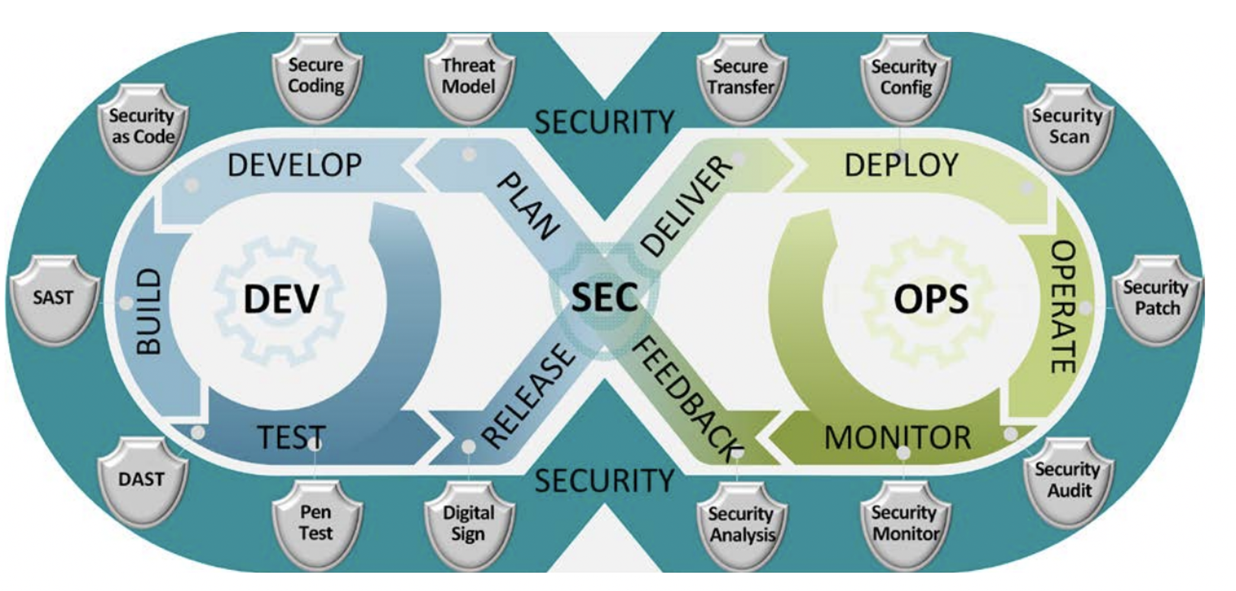
DevsecOps
DevSecOps (Development, Security, and Operations)
Integrates security practices into every phase of the development and delivery pipeline
Core Idea
Traditional DevOps improves speed and collaboration, but often risks overlooking security until late in the process.
DevSecOps shifts security left
Embedding automated security checks, compliance controls, and risk management early and continuously throughout the lifecycle

Slide 74
Devsecops key principles
Shift security left
Incorporate security reviews, code scans, and threat modeling at the earliest stages
Prevent vulnerabilities rather than reacting to them after release
Automation of security controls
Security testing becomes part of the CI/CD pipeline
For example: static code analysis, dependency scanning, container image checks
Automated policy enforcement ensures compliance without slowing down delivery
Collaboration and shared responsibility
Security, Dev, and Ops teams collaborate to build secure systems by design
Security champions often embed within development teams to guide best practices

Slide 75
Devsecops key principles
Continuous monitoring and feedback
Runtime monitoring, logging, and incident response are integrated to detect and respond to threats quickly
Feedback loops turn incidents into learning opportunities
Security as code / policy as code
Infrastructure, configurations, and security policies are version-controlled, tested, and able to be audited
Improves traceability and recovery

Slide 76
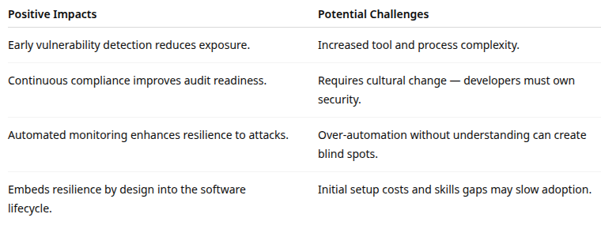
Devsecops key principles

Slide 77
Cicd basics
CICD is not a methodology
It is not Agile or DevOps
Although both rely on CICD and use it extensively
CICD is process automation applied to SE
Similar to other kinds of automation
Improves process efficiency and effectiveness
CICD is process agnostic
Can be used anywhere a SE process is well defined
Using CICD with bad processes makes them worse
A fool with a tool is still a fool
Martin Fowler
A computer lets you make more mistakes faster than any invention in human history – with the possible exceptions of handguns and tequila
Mitch Ratcliffe

Slide 78
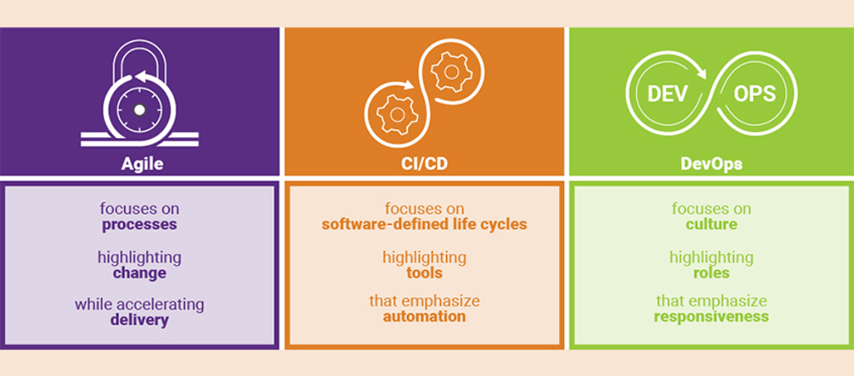
Agile, DevOps and CICD

Slide 79
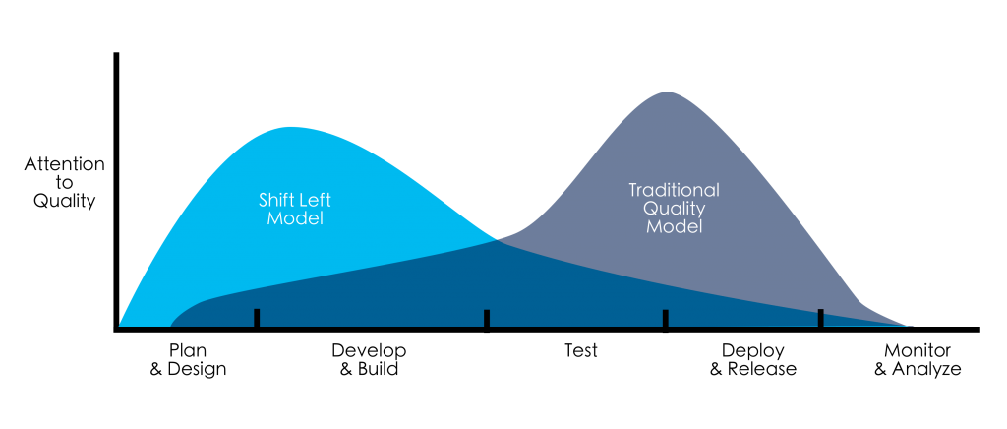
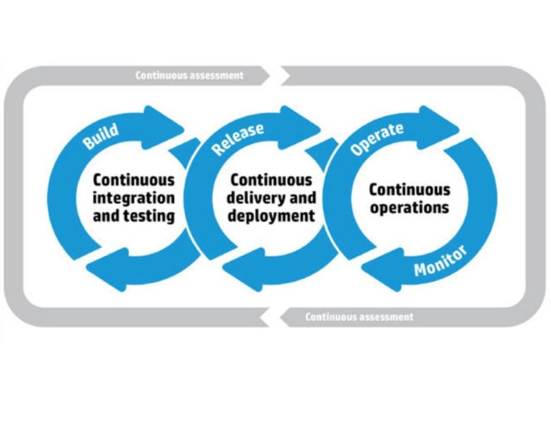
Continuous Testing
Continuous Testing
Every artifact is tested as it is created
Shift Left Model
Test early, test often
CICD also adds
Automated testing at every stage
CT is triggered by events in the CICD process
Checking in code => automated unit testing
Build => integration testing

Slide 80
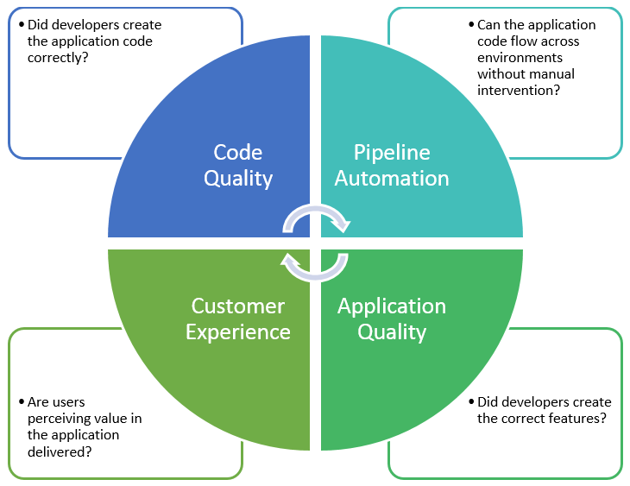
Continuous Testing
Does not replace human based testing
Like pair programming and code reviews
Creates “quality gates”
Development pipelines abort when tests fail

Slide 81
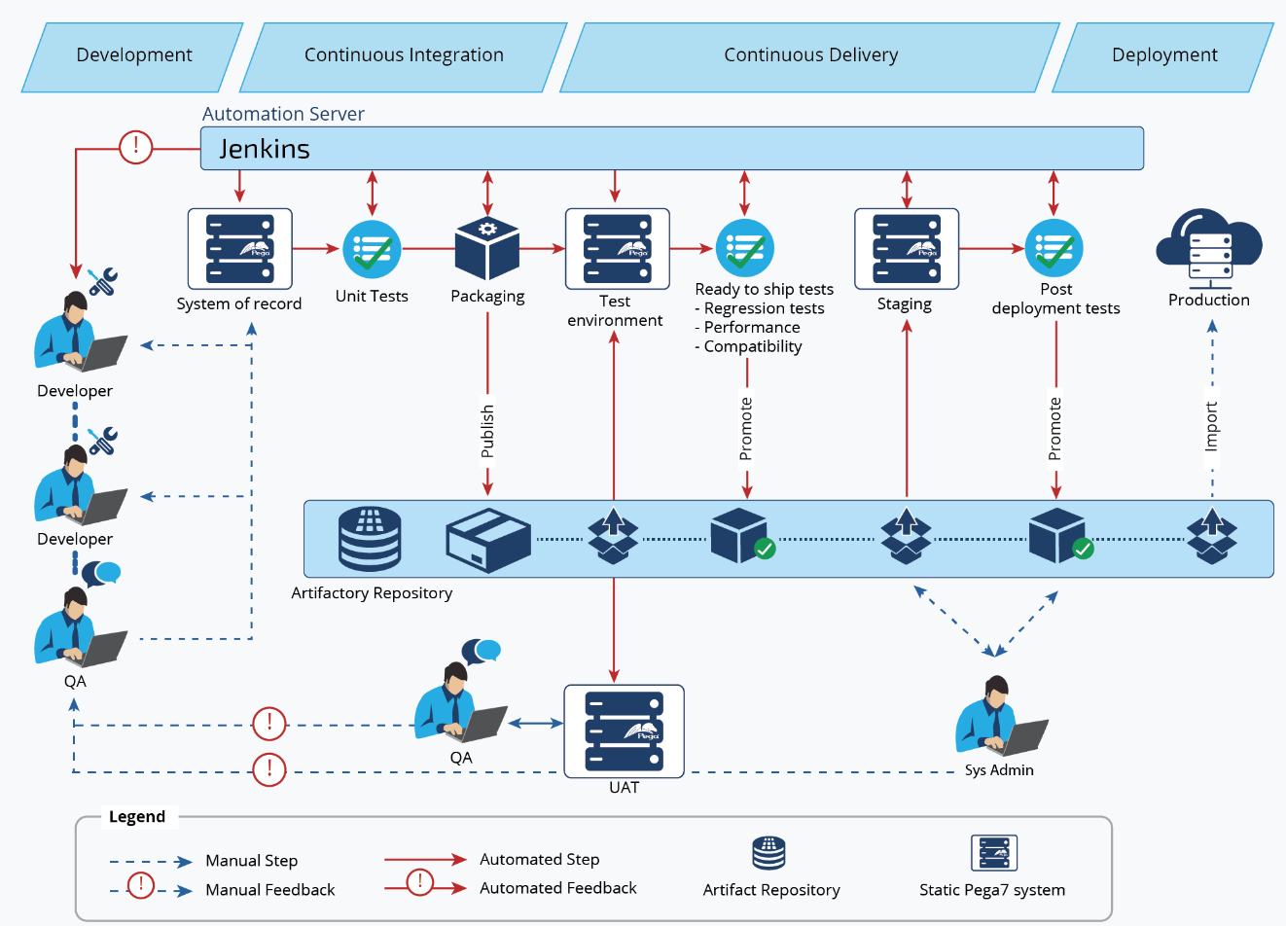
Pipelines

Slide 82
CICD Benefits
Smaller code changes are simpler (more atomic) and have fewer unintended consequences
Fault isolation is simpler and quicker.
Mean time to resolution (MTTR) is shorter because of the smaller code changes and quicker fault isolation
Testability improves due to smaller, specific changes
These smaller changes allow more accurate positive and negative tests
Elapsed time to detect and correct production escapes is shorter with a faster rate of release
The backlog of non-critical defects is lower because defects are often fixed before other feature pressures arise
The product improves rapidly through fast feature introduction and fast turn-around on feature changes
Upgrades introduce smaller units of change and are less disruptive

Slide 83
CICD Benefits
CI-CD product feature velocity is high
The high velocity improves the time spent investigating and patching defects
Feature toggles and blue-green deploys enable seamless, targeted introduction of new production features
You can introduce critical changes during non-critical (regional) hours
This non-critical hour change introduction limits the potential impact of a deployment problem
Release cycles are shorter with targeted releases and this blocks fewer features that aren’t ready for release
End-user involvement and feedback during continuous development leads to usability improvements
You can add new requirements based on customer’s needs on a daily basis

Slide 84
CICD risk downsides
Change volume and cognitive load risks
Downside of smaller code changes, faster releases, rapid feature introduction
Change saturation
The number of changes increases, which can overwhelm teams, reviewers, and operations
Context loss
Engineers may lose the broader system context when working on highly atomic changes, leading to suboptimal design decisions
Review fatigue
High-frequency pull requests can result in shallow reviews or rubber-stamping
Traceability gaps
Mapping many small changes to business outcomes, requirements, or incidents becomes harder without strong tooling

Slide 85
CICD risk downsides
Quality and testing risks
Downside of improved testability, better positive/negative tests, faster detection
False confidence in automation
Heavy reliance on automated tests can mask gaps in test coverage
For example: edge cases, usability, performance
Test debt accumulation
Rapid delivery can cause poorly designed or flaky tests to accumulate
Overfitting tests to implementation
Small changes may lead to tests that validate how code works, not what the system should do
Reduced exploratory testing
Speed pressure may reduce time spent on human-driven testing and system-level validation.

Slide 86
CICD risk downsides
Production stability risks
Downside of faster MTTR, quicker fault isolation, smaller upgrades
Increased production volatility
Frequent releases increase the likelihood of customer-facing changes, even if individual changes are small
Failure blast radius underestimation
A small change can still have systemic impact in tightly coupled architectures
Rollback complexity
With many interdependent small changes, rolling back a single issue may not be straightforward
Configuration drift
CI/CD pipelines that deploy frequently may exacerbate environment inconsistencies

Slide 87
CICD risk downsides
Security and compliance risks
Downside of faster release cycles, smaller units of change
Security review bypass risk
Speed may lead to reduced manual security reviews or skipped threat modeling
Vulnerability propagation
Vulnerabilities can spread rapidly to production if not detected early
Secrets exposure
CI/CD pipelines often require credentials, increasing the risk of secret leakage
Audit and compliance gaps
High deployment frequency can challenge traditional audit trails, approvals, and segregation-of-duties models

Slide 88
CICD risk downsides
Incident and operational risks
Downside of faster detection and resolution
Alert fatigue
Frequent changes can generate frequent alerts, reducing signal-to-noise ratio
Root cause ambiguity
When multiple changes are deployed in close succession, identifying the true root cause can still be difficult
Operational dependency risk
Operations teams become tightly dependent on CI/CD tooling availability and correctness
Pipeline failure impact
CI/CD pipeline outages can block all releases, becoming a single point of failure

Slide 89
CICD risk downsides
Governance and control risks
Downside of reduced backlog, rapid improvement
Erosion of change control discipline
Traditional approval gates may be weakened or removed without adequate replacement controls
Inconsistent standards enforcement
Without strong policy-as-code, teams may diverge in quality, security, or documentation practices
Shadow releases
Teams may deploy changes without full stakeholder awareness due to automation opacity
Metrics misalignment
Overemphasis on deployment frequency can overshadow stability, customer impact, or long-term quality

Slide 90
CICD risk downsides
Organizational and cultural risks
Downside of fast turnaround, rapid product improvement
Burnout risk
Constant delivery pressure can increase stress and reduce sustainability
Skill gap exposure
CI/CD requires strong engineering discipline; immature teams may struggle
Blame amplification
High visibility of frequent changes can lead to unhealthy blame cultures if incidents occur
Uneven ownership
Faster cycles can blur accountability between development, QA, and operations

Slide 91
CICD risk downsides
Architecture and technical debt Risks
Downside of smaller upgrades, faster feature changes
Local optimization risk
Small changes may optimize locally while degrading overall system architecture
Deferred refactoring
Teams may repeatedly ship incremental fixes instead of addressing structural issues
Coupling amplification
CI/CD exposes tight coupling faster but does not fix it; frequent breakages may occur
Backward compatibility erosion
Rapid iteration can unintentionally break consumers or integrations

Slide 92

Q&A and open discussion
Notes:
Now is the time to engage in an interactive Q&A session where you can ask questions, share insights, and clarify any doubts about the topics we have covered so far.
This open discussion is designed to ensure that every participant has the opportunity to voice their thoughts and learn from the collective experience of the group.
Your questions and comments are valuable as they help us identify areas that may need further explanation and enable us to tailor future sessions to your needs.
We encourage you to speak up and contribute to the dialogue, as this interaction is one of the key components of our interactive learning approach.
As the session progresses, take note of any questions or ideas that you would like to revisit, and feel free to share your perspectives with the class.

